Slide 1
Embedded Real-Time OSs: eCos and RTLinux
Lecture 2

Slide 2
What Is eCos ?
Stands for “Embedded Configurable Operating System”
Developed and maintained by RedHat.
eCos features:
  Not Linux-based
  Minimum footprint: about 50KB
  Single address space
  Real-time support
  Support ROMFS, RAMFS and JFFS2
  SMP support

Slide 3
eCos History
1996 Cygnus started eCos project.
1998 eCos 1.1 released (first public release.)
1999 Red Hat acquired Cygnus Solutions.
2000 eCos 1.3.1 released under Red Hat eCos Public License.
2000 Red Hat announce the availability of Redboot
2002 eCos 2.0-alpha released under GPL+ exception.
2002 original members of eCos team formed eCosCentric Limited in Cambridge.

Slide 4
eCos History
2002 Red Hat announced their withdrawal from RTOS market, laid off entire eCos team.
2003 eCos 2.0-final was released.
2003 eCosCentric announced eCosPro Developer‘s Kit.
2004 Red Hat announce intention to assign copy right of the portions of the original source base to FSF.

Slide 5
eCos Architecture
Applications
Libraries
Compatibility
Math
C
POSIX
μITRON
Target
Independent
Kernel
Networking Stack
File System
RedBoot ROM monitor
Hardware Abstract Layer (HAL)
Device Drivers
interrupts
vectors
exceptions
flash
serial
networking
Target Hardware

Slide 6
eCos Core Component
HAL: a software layer that gives general access to the hardware.
Kernel: interrupt and exception handling, thread and synchronization support, scheduler implementation, timer, counter and alarm.
ISO C and Math libraries: Standard compatibility with function calls
Device driver: Serial, Ethernet, Flash ROM etc.
GDB support: provides target software for communicating with a GDB host.
Notes:
Designed as a full-featured, real-time operating system, eCos delivers a complete suite of functions needed in many embedded applications including:
Hardware Abstraction Layer (HAL) -provides a software layer that gives access to hardware.
Kernel - includes interrupt and exception handling, thread and synchronization support, a choice of scheduler implementations, timers, counters and alarms.
ISO C and math libraries – provide standard compatibility with function calls.
Device Drivers - include standard serial, Ethernet, Flash ROM, and others.
GDB support - provides target software for communication with a GDB host enabling application debugger.

Slide 7
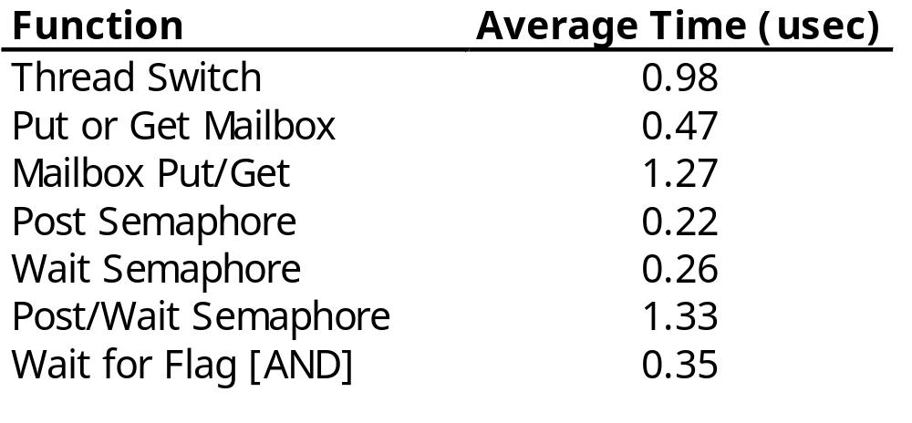
Kernel Benchmark
Timing benchmarks generated on the Model 4205 MPC7455/57 processor board running at 600 MHz and configured with a 2 Mbyte L3 cache:

Slide 8
POSIX Standard
Portable Operating System Interface for Computer Environments | POSIX.1 | ISO 9945-1
Shell and Utility | POSIX.2 | ISO 9945-2
Realtime API | POSIX.1b | IEEE 1003.1b
Operating Security API | POSIX.1e | IEEE 1003.1e
Operating Security Commands | POSIX.2c | IEEE 1003.2c
eCos contains support for partial POSIX Specification (ISO/IEC 9945-1:1996 POSIX.1)

Slide 9
ISO C In eCos
eCos provides a math library, which implements the mathematical functions from the ISO C library
There are 4 compatibility modes:
  ANSI/POSIX 1003.1;
  IEEE-754;
  X/Open Portability Guide issue 3 (XPG3);
  System V Interface Definition Edition 3

Slide 10
eCos vs. Linux
 | Components | Linux | eCos
 | MMU | O | X
 | Memory map | Virtual & Physical | Single address space
 | License | GPL | eCos license
 | ISO C library | O | Separate Math lib
 | POSIX |  | Not fully support
 | TCL/TK | O | X
 | Real-time | X | (selected boards only)
 | Device driver | In the kernel | Separate from kernel
 | Minimal footprint | About 2MB | About 50KB

Slide 11
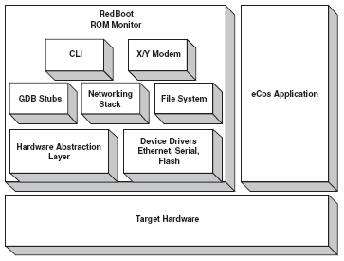
Redboot Architecture

Slide 12
The Features of Redboot
Based on eCos HAL
Boot scripting support
Simple command line interface
Support flash & network booting
Support BOOTP, DHCP
Support TFTP, X/Y-modem for program download
Support GDB for remote debugging via serial or Ethernet connections

Slide 13
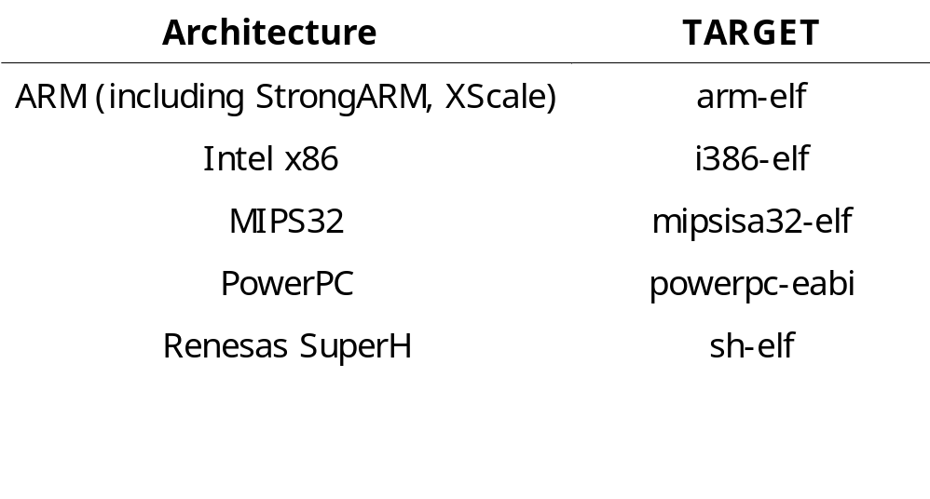
Installation and Development Environment
Install cygwin under Windows
  http://www.cygwin.com/setup.exe
  Select additional packages: gcc, make, sharutils, tcltk, wget
Installing eCos
  Under cygwin bash shell:
  wget --passive-ftp ftp://ecos.sourceware.org/pub/ecos/ecos-install.tcl
  Select GNU tools for target

Slide 14
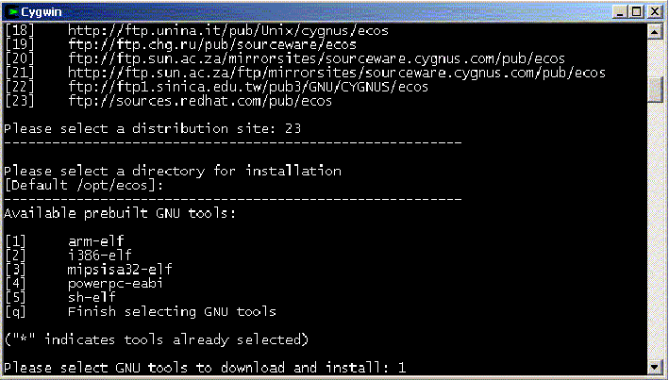
Installation snapshot

Slide 15
Building eCos
Graphical tool : Configtool
  There is a bug between eCos and Cygwin
  Default at “/opt/ecos/ecos-2.0/tools/bin”
  Select target (Build→ Template)
  Config your options
  Build eCos (Build→Library)

Slide 16
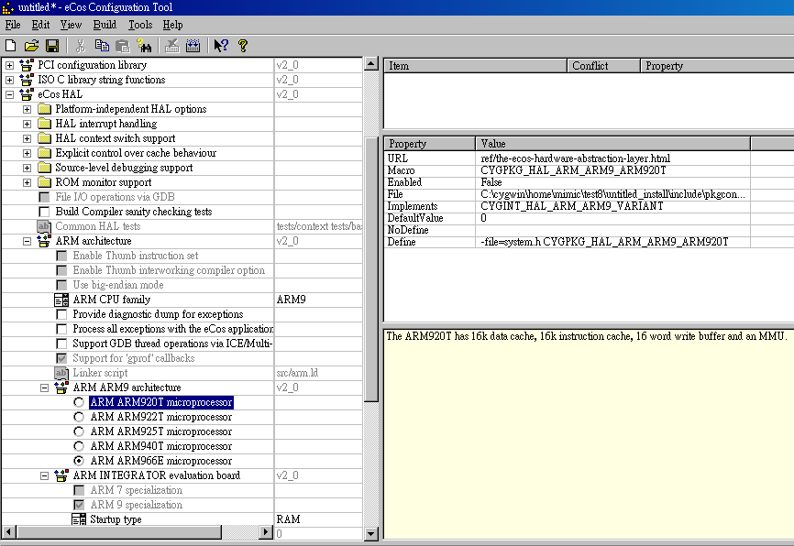
Configtool Snapshot

Slide 17
RTLinux v.s. Linux

Slide 18
Defects of Linux
Linux scheduling algorithms are not designed for real-time tasks.
  Linux will “batch” operations to make more efficient use of the hardware.
Linux scheduling is unpredictable.
  Linux processes are heavyweight processes.
  It can take several hundred microseconds to finish a context switch.
Linux Timer resolution is coarse, 10 ms.
Linux Kernel is Non-preemptible .
  Even the lowest priority task is running.
  Linux will make high priority tasks wait for low priority tasks to release resources.
Linux disables interrupts used for coarse-grained synchronization.
  “Coarse grained” synchronization means that there are long intervals when one task has exclusive use of some data.
Linux uses virtual memory.
Linux reorders requests for efficiency (e.g., for disk I/O).

Slide 19
RTLinux
RT-Linux is an operating system in which a small real-time kernel coexists with the POSIX-like Linux kernel.
RTLinux is module oriented.
  Scheduler.
    The “earliest deadline first” scheduler.
    Rate-monotonic scheduler.
  The module that implements RT-FIFOs.
RTLinux decouples the mechanisms of the real-time kernel from the mechanisms of the general purpose kernel.
  Each can be optimized independently.
  The RT kernel can be kept small and simple.

Slide 20
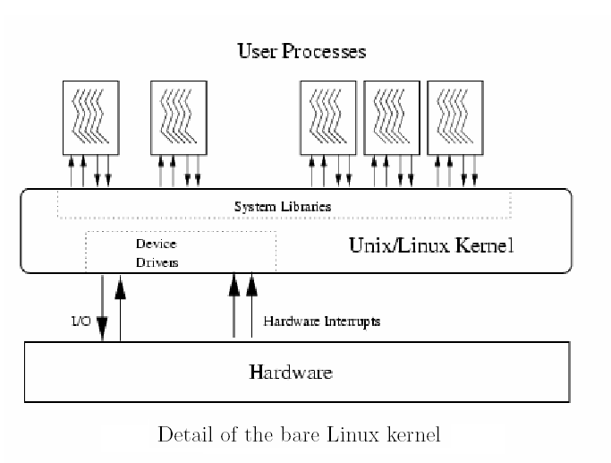

Slide 21
RTLinux Features
Real-time scheduling algorithm.
Predictable delays.
  By its small size and limited operations.
Finer timer resolution.
Preemptible kernel.
  The RTLinux executive is itself nonpreemptible.
  Its routine are very small and fast, this does not cause big delays.
  Interrupts from Linux are disabled.
No virtual memory.

Slide 22
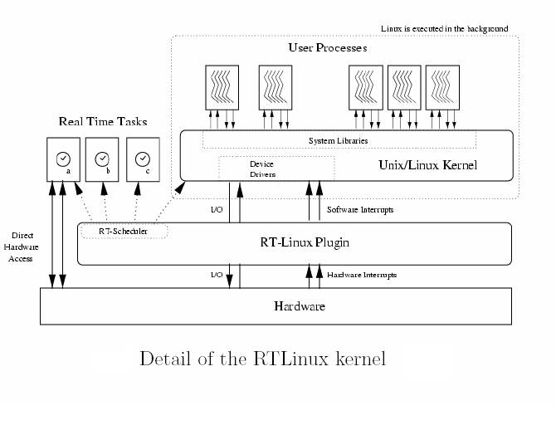

Slide 23
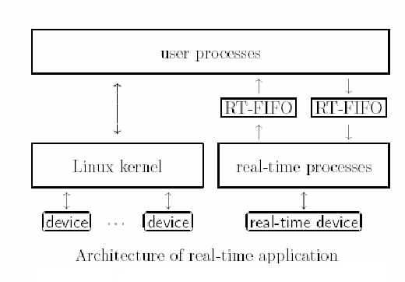

Slide 24
Scheduler
RT-Linux contains a dynamic scheduler.
RT-Linux has many kinds of Schedulers.
  FIFO.
  The “earliest deadline first” scheduler.
  Rate-monotonic scheduler.

Slide 25
RT FIFO
Real-time FIFOs are used to pass information between real-time process and ordinary Linux process.
Real-time FIFOs are designed to never block the real-time task.
RT-FIFOs are, like real-time tasks, never paged out. This eliminates the problem of unpredictable delays due to paging.

Slide 26
Timer Resolution
If the kernel was patched with UTIME, we could schedule processes with microsecond resolution.
Running rtlinux-V3.0 Kernel 2.2.19 on the 486 allows stable hard real-time operation. Giving:
  15 microseconds worst case jitter.
  10 microseconds event resolution.
  17 nanoseconds timer resolution.
  6 microseconds interrupt response time. (This value was measured on interrupts on the parallel port)
High resolution timing functions give nanosecond resolution (limited by the hardware only.)

Slide 27
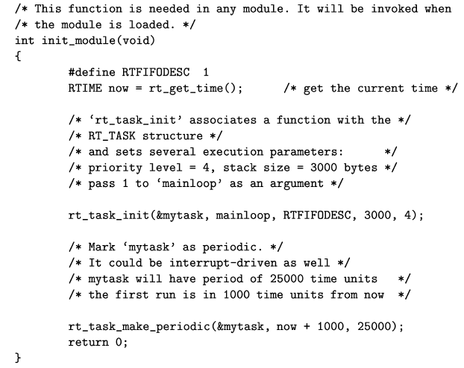

Slide 28




Applications

Slide 29
Linux, RTLinux, and RTAI
 | Linux | RTLinux | RTAI
Hardware | Alpha, ARM, i386, MIPS, PowerPC, Sparc, SuperH, Etrax, m68k, PA-RISC | i386, PPC, ARM, Alpha, MIPS | i386, MIPS, PPC, ARM, m68k-nommu
Multi-processor | Yes | Yes | Yes
Scheduling | SCHED_FIFO, SCHED_RR, SCHED_OTHER | SCHED_FIFO, EDF, and RM | Fixed priority
Processes | UNIX-processes & Pthreads | Pthreads | Lightweight processes
Priorities lower - higher | (0-100) | (0-1,000,000) | 0x3fffFfff-0)
Memory protection | Yes | No | Yes
Dynamic memory | Yes | No | Yes
Inter-process communication | Semaphores, Mutexes, Condition-var., shared-mem, signals, pipes. | Semaphores, Mutexes, Condition-var., FIFO | Semaphores, Mutexes, Condition-var., FIFO, Mailbox, shared-mem, net_rpc, Pqueues.

Slide 30
Linux, RTLinux, and RTAI
 | Linux | RTLinux | RTAI
Priority inversion control | None | Immediate ceiling | Inheritance
Time resolution | Configurable (HighResTimers) | Hardware dependant | Hardware dependant
Timers | POSIX timers | None | None
Low level programming | No interrupt programming. | Full control HW | Full control HW
QoS | FIFO, CBQ, CSZ, ATM, PRIO, RED, SFQ, TLE, TBF, GRED, Diffserv, Ingress, RSVP | None | None
Network | IP, UDP, TCP, SLIP, PPP, ICMP, DHCP, RARP, RARP, TFTP, RPC, FTP, HTTP | None | None
File Systems | ReiserFS, ext2, ext3, NFS, CIFS, ADFS, FAT, VFAT, NTFS, CRAMFS, ISO9660, MINIX, QNX4, ROM, JFS, XFS, Flash | None | None
Inter-process communication | Semaphores, Mutexes, Condition-var., shared-mem, signals, pipes. | Semaphores, Mutexes, Condition-var., FIFO | Semaphores, Mutexes, Condition-var., FIFO, Mailbox, shared-mem, net_rpc, Pqueues.

Slide 31
Comparison (Cont.)
 | Debug | Languages | API compatibility
Linux | GDB, DDD, Insight, System debugg, and LTT | C, C++, ADA, Java, etc. | POSIX 1003.1, VxWorks, pSOS
RTLinux | Simple trace, GDB | C, C++ | POSIX 1003.1c
RTAI | KGDB | C | Custom, POSIX 1003.1b

Slide 32
Conclusion
Test Metrics (ns) | eCos | RTLinux
Thread Creation Latency | 16,130 – 34,300 | 137,216
Thread Deletion Latency | 5,350 – 6,450 | 8,448
Mutex Latency | 5,043 -25,340 | 5,043 – 46,912

Slide 33
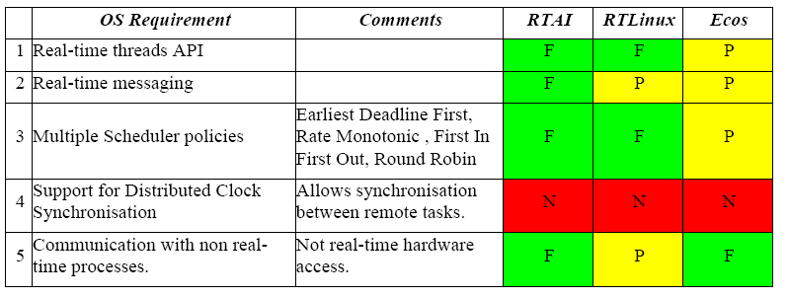
Conclusion (Cont.)

Slide 34
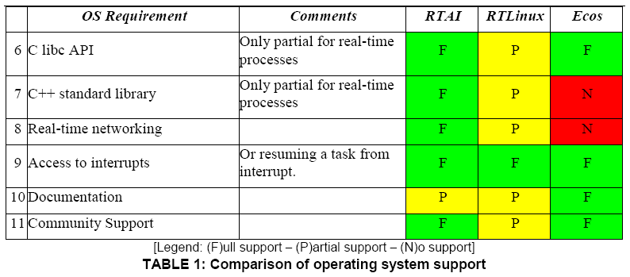
Conclusion (Cont.)

Slide 35
Introduction to Real-Time Process Scheduling

Slide 36
Introduction to Real-Time Process Scheduling
Q: Many theories and algorithms in real-time process scheduling seem to have simplified assumptions without direct solutions to engineers’ problems. Why should we know them?
A:
  Provide insight in choosing a good system design and scheduling algorithm.
  Avoid poor or erroneous choices.

Slide 37
Introduction to Real-Time Process Scheduling
Checklist
  What do we really know about the rate monotonic (RM) and the earliest deadline first (EDF) scheduling?
  What is known about uniprocessor real-time scheduling problems?
  What is known about multiprocessor real-time scheduling problems?
  What task-set characteristics cause NP-hard?
  What is the impact of overloads on the scheduling results?
  What do we really know about theories for off-line schedulability such as the rate monotonic analysis?

Slide 38
Introduction to Real-Time Process
Scheduling
Time
Job Shop Scheduling
Independent Process Scheduling
(Liu & Layland, 1973, etc.)
Multiprocessor Process Scheduling
(Dhall, 1972-, etc.)
Process Scheduling with
Non-Preemptable Resources
(Mok, 1983, Sha, Rajkumar, 1986, Baker, 1991, etc.)
Sporadic Process Scheduling
(Sprunt, 1989, etc.)
Non-preemptable Scheduling
(Baruah, 1990-, etc.)
Process Scheduling with End-to-End Delays
(Stankovic, Gerber, Lin, etc, since ?.)
Process Scheduling with
Probabilistic Guarantee
(Liu, Lehoczky, etc, since 1995.)
Process Scheduling with
Realistic Task Characteristics
(Liu, Mok, etc, since 1996.)
Process Scheduling with Multiple Resources
Rate-Based Scheduling
(Buttazzo, Liu, Brauah, Kuo, etc, since 1995.)

Slide 39
Uni-process Scheduling
Fixed-Priority vs. Dynamic-Priority Scheduling
Rate-Monotonic Scheduling Algorithm
Earliest Deadline First Scheduling

Slide 40
Process Model
Periodic process
  each periodic process arrives at a regular frequency – a special case of demand.
  r: ready time, d: relative deadline, p: period, c: worst case computation time.
  For example, maintaining a display
Sporadic process
  An aperiodic process with bounded inter-arrival time p.
  For example, turning on a light
Other requirements and issues:
  process synchronization including precedence and critical sections, process value, etc.

Slide 41
Performance Metrics
Metrics for hard real-time processes:
  Schedulability, etc.
Metrics for soft real-time processes:
  Miss ratio
  Accumulated value
  Response time, etc.
Other metrics:
  Optimality, overload handling, mode-change handling, stability, jitter, etc.
  Combinations of metrics.

Slide 42
Definitions
Preemptive scheduling: allows process preemptions. (vs. nonpreemptive scheduling)
Online scheduling: allocates resources for processes depending on the current workload. (vs. offline scheduling)
Static scheduling: operates on a fixed set of processes and produces a single schedule that is fixed at all time. (vs. dynamic scheduling)
Firm real-time process: will be killed after it misses its deadline. (vs. hard and soft real-time)
Fixed-priority scheduling: in which the priority of each process is fixed for any instantiation. (vs. dynamic-priority scheduling)

Slide 43
Rate Monotonic Scheduling Algorithm
Assumptions:
  all periodic fixed-priority processes
  relative deadline = period
  independent process - no non-preemptable resources
Rate Monotonic (RM) Scheduling Algorithm
  RM priority assignment: priority ~ 1/period.
  preemptive priority-driven scheduling.
Example: T1 (p1=4, c1=2) and T2 (p2=5, c1=1)
0
1
2
3
4
5
6
7
8

Slide 44
Rate Monotonic Scheduling
Algorithm
Critical Instant
  An instant at which a request of the process have the largest completion/response time.
  An instance at which the process is requested simultaneously with requests of all higher priority processes.
Usages
  Worst-case analysis
  Fully utilization of the processor power
  Example: T1 (p1=4, c1=2) and T2 (p2=5, c2=1􀃆2)
0
1
2
3
4
5
6
7
8

Slide 45

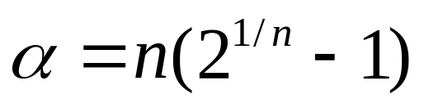
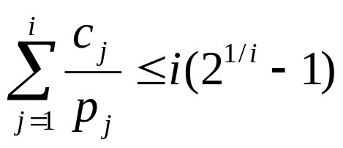
Rate-Monotonic Analysis
Schedulability Test:
  A sufficient but not necessary condition.
  Achievable utilization factor αof a scheduling policy P: any process set with total utilization factor no more than α is schedulable.
  Given n processes,
Stability:
  Let processes be sorted in RM order. The ith process is schedulable if
  An optimal fixed priority scheduling algorithm

Slide 46
Application
RM was chosen by
  Space Station Freedom Project
  FAA Advanced Automation System (AAS)
RM influenced the specs of IEEE Futurebus+
RMA is widely used for off-line analysis of time-critical systems.

Slide 47
Earliest Deadline First Scheduling
Algorithm
Assumptions (similar to RM):
  all periodic dynamic-priority processes
  relative deadline = period
  independent process - no non-preemptable resources
Earliest Deadline First (EDF) Scheduling Algorithm:
  EDF priority assignment: priority ~ absolute deadline. i.e., arrival time t + relative deadline d.
  preemptive priority-driven scheduling
Example: T₁(c₁=1, p₁=2), T₂(c₂=2, p₂=7)
0
1
2
3
4
5
6
7
8

Slide 48
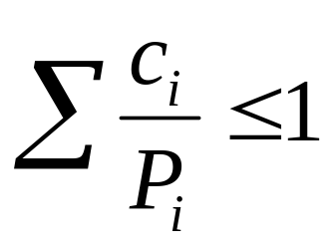
Earliest Deadline First Scheduling
Algorithm
Schedulability Test:
  A sufficient and necessary condition
  Any process set is schedulable by EDF iff
EDF is optimal for any independent process scheduling algorithms.
However, its implementation has considerable overheads on OS’s with a fixed-priority scheduler and is bad for (transiently) overloaded systems.

